Slide 1
Module 3: Virtual Machines

Slide 2
Importance
You can create a virtual machine in several ways. Choosing the correct method can save you time and make the deployment process manageable and scalable.

Slide 3
Module Lessons
Creating Virtual Machines
Virtual Machine Hardware Deep Dive
Introduction to Containers

Slide 4
Virtual Beans: Virtualizing Workloads
Virtual Beans uses internally developed applications that run in an environment with Windows and Linux systems.
Virtual Beans requires that 100% of their workloads be virtualized:
Business-critical applications
Nonbusiness-critical applications
In addition, Virtual Beans application developers are creating and testing a new order-fulfillment system based on container technology.
As a Virtual Beans administrator, you must familiarize yourself with the components of a virtual machine and the virtual devices that are supported. You also want to learn about containers because future applications will use this technology.

Slide 5
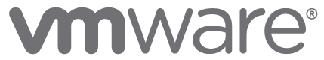
Lesson 1: Creating Virtual Machines

Slide 6
Learner Objectives
After completing this lesson, you should be able to meet the following objectives:
Create and provision a virtual machine
Describe how to import a virtual appliance OVF template
Explain the importance of VMware Tools
Install VMware Tools

Slide 7
About Provisioning Virtual Machines
You can create VMs in several ways:
Use the New Virtual Machine wizard to create a single VM using:
The vSphere Client
VMware Host Client
Use the vSphere Client to deploy VMs in the following formats:
New VMs from existing templates or clones
VMs, virtual appliances, and vApps stored in OVF format
Notes:
The optimal method for provisioning VMs for your environment depends on factors such as the size and type of your infrastructure and the goals that you want to achieve.
You can use the New Virtual Machine wizard to create a single VM if no other VMs in your environment meet your requirements, such as a particular operating system or hardware configuration. For example, you might need a VM that is configured only for testing purposes. You can also create a single VM, install an operating system on it, and use that VM as a template from which to clone other VMs.
Deploy VMs, virtual appliances, and vApps stored in Open Virtual Machine Format (OVF) to use a preconfigured VM. A virtual appliance is a VM that typically has an operating system and other software preinstalled. You can deploy VMs from OVF templates that are on local file systems (for example, local disks such as C:), removable media (for example, CDs or USB keychain drives), shared network drives, or URLs.
In addition to using the vSphere Client, you can also use VMware Host Client to create a VM by using OVF files. However, several limitations apply when you use VMware Host Client for this deployment method. For information about OVF and OVA limitations for the VMware Host Client, see vSphere Single Host Management - VMware Host Client at https://docs.vmware.com/en/VMware-vSphere/7.0/com.vmware.vsphere.hostclient.doc/GUID-509C12B2-32F2-4928-B81B-DE87C7B2A5F6.html.

Slide 8
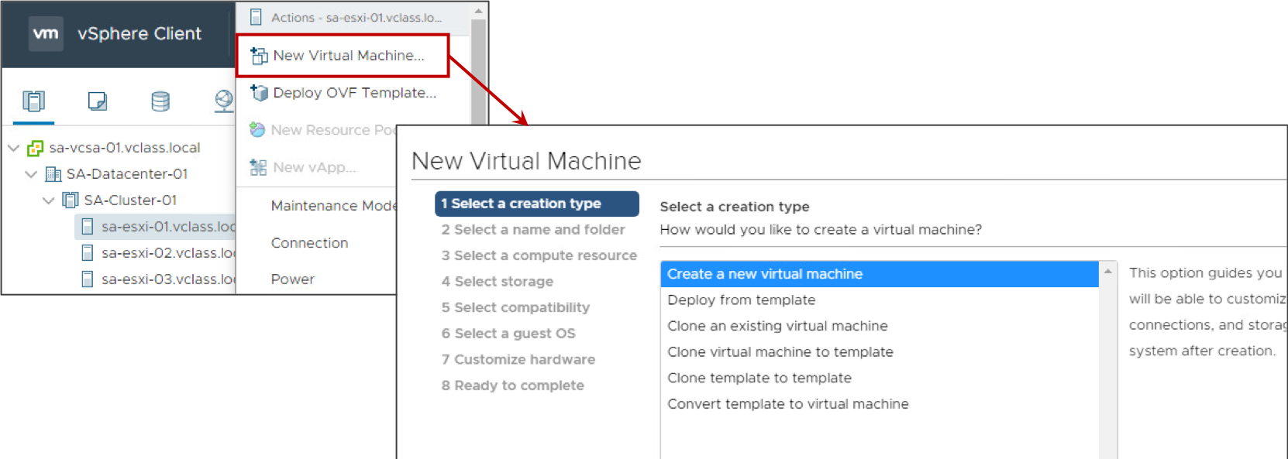
Creating VMs with the New Virtual Machine Wizard (1)
You can use the New Virtual Machine wizard in the vSphere Client to create a VM.

Slide 9
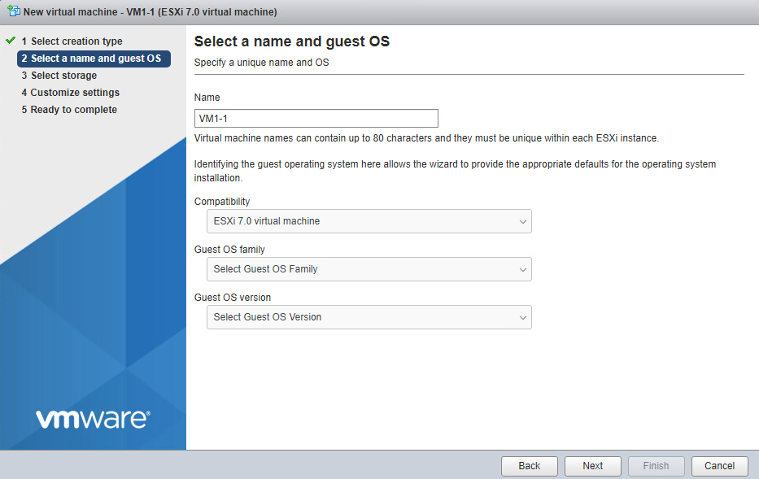
Creating VMs with the New Virtual Machine Wizard (2)
You can use the New Virtual Machine wizard in VMware Host Client to create a VM.
Notes:
The New Virtual Machine wizard prompts you for standard information:
The VM name
If using the vSphere Client, you can also specify the folder in which to place the VM.
The resource on which the VM runs
If using VMware Host Client, you create the VM on the host that you are logged in to.
If using the vSphere Client, you can specify a host, a cluster, a vApp, or a resource pool. The VM can access the resources of the selected object.
The datastore on which to store the VM’s files
Each datastore might have a different size, speed, availability, and other properties. The available datastores are accessible from the destination resource that you select.
The guest operating system to be installed into the VM
The number of NICs, the network to connect to, and the network adapter type
Virtual disk provisioning choice

Slide 10
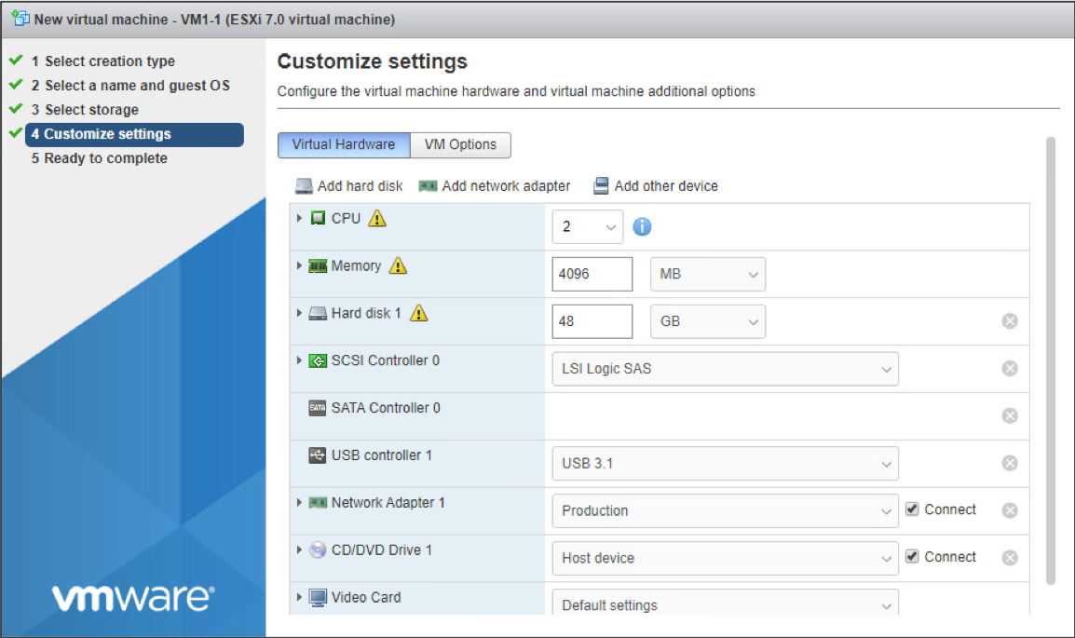
New Virtual Machine Wizard Settings
VM configuration settings are based on prior choices that you made about the operating system.

Slide 11
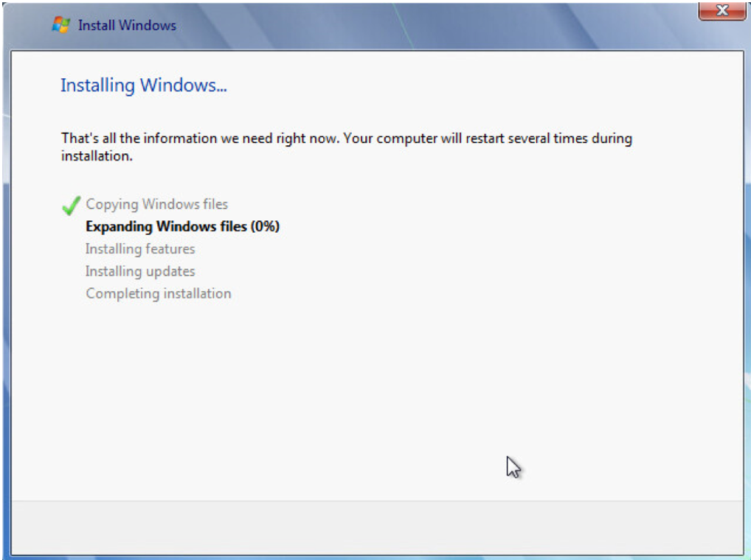
Installing the Guest Operating System
Installing a guest operating system in your VM is similar to installing it on a physical computer.
Notes:
To install the guest operating system, you interact with the VM through the VM console. Using the vSphere Client, you can attach a CD, DVD, or ISO image containing the installation image to the virtual CD/DVD drive.
On the slide, the Windows Server 2008 guest operating system is being installed. You can use the vSphere Client to install a guest operating system. You can also install a guest operating system from an ISO image or a CD. Installing from an ISO image is typically faster and more convenient than a CD installation.
For more information about installing guest operating systems, see vSphere Virtual Machine Administration at https://docs.vmware.com/en/VMware-vSphere/7.0/com.vmware.vsphere.vm_admin.doc/GUID-55238059-912E-411F-A0E9-A7A536972A91.html.
For more about the supported guest operating systems, see VMware Compatibility Guide at https://www.vmware.com/resources/compatibility.

Slide 12
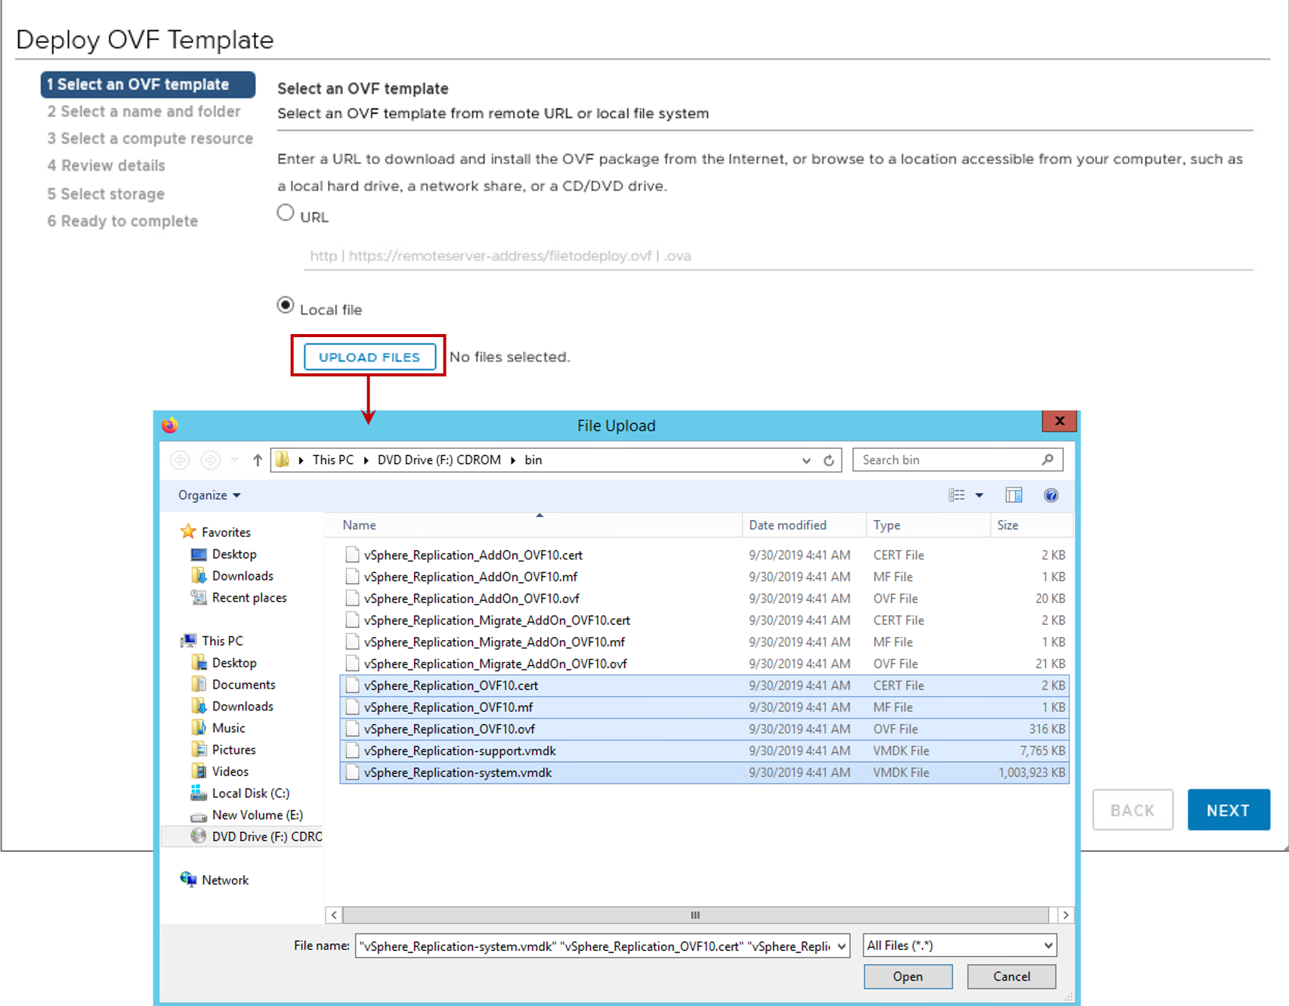
Deploying OVF Templates
You can deploy any VM or virtual appliance stored in OVF format.
Virtual appliances are preconfigured VMs:
They are usually designed for a single purpose.
They are also available from VMware Solution Exchange.
Notes:
A virtual appliance is a preconfigured VM that typically includes a preinstalled guest operating system and other software. A virtual appliance is usually designed for a specific purpose, for example, to provide a secure web browser, a firewall, or a backup and recovery utility.
A virtual appliance can be added or imported to your vCenter Server system inventory or ESXi inventory. Virtual appliances can be imported from websites such as the VMware Virtual Appliance Marketplace at https://marketplace.vmware.com/vsx/.
Virtual appliances are deployed as OVF templates. OVF is a platform-independent, efficient, extensible, and open packaging and distribution format for VMs. OVF files are compressed, resulting in faster downloads. The vSphere Client validates an OVF file before importing it and ensures that it is compatible with the intended destination server. If the appliance is incompatible with the selected host, you cannot import it.

Slide 13
About VMware Tools
VMware Tools is a set of features that enhance the performance of a VM’s guest operating system.
Benefits and features include:
Device drivers
SVGA display
VMXNET/VMXNET3
Balloon driver for memory management
Sync driver for quiescing I/O
Increased graphics performance
Improved mouse performance
Guest OS heartbeat service
Time synchronization
Ability to shut down the VM
Notes:
VMware Tools improves management of the VM by replacing generic operating system drivers with VMware drivers tuned for virtual hardware. You install VMware Tools into the guest operating system. When you install VMware Tools, you install these items:
The VMware Tools service: This service synchronizes the time in the guest operating system with the time in the host operating system.
A set of VMware device drivers, with additional Perfmon monitoring options.
A set of scripts that helps you automate guest operating system operations: You can configure the scripts to run when the VM's power state changes.
VMware Tools enhances the performance of a VM and makes many of the ease-of-use features in VMware products possible:
Faster graphics performance and Windows Aero on operating systems that support Aero
Shared folders between host and guest file systems
Copying and pasting text, graphics, and files between the virtual machine and the host or client desktop
Scripting that helps automate guest operating system operations
Although the guest operating system can run without VMware Tools, many VMware features are not available until you install VMware Tools. For example, if VMware Tools is not installed in your VM, you cannot use the shutdown or restart options from the toolbar. You can use only the power options.

Slide 14
Installing VMware Tools
Ensure that you select the correct version of VMware Tools for your guest operating system.
To find out which VMware Tools ISO images are bundled with vSphere 7, see the vSphere 7 Release Notes.
The method for installing VMware Tools depends on the guest operating system type.
Guest Operating System Type | VMware Tools Installation Method
Microsoft Windows | Install from windows.iso for Vista and later guests.
Linux | To allow vSphere to manage the installation, install from linux.iso.
 | To allow the guest OS to manage the installation, use open-vm-tools, available in various Linux package management systems, such as yum, apt, or rpm.
MacOS | Install from darwin.iso for Mac OS X versions 10.11 and later.
Solaris | Install from solaris.iso for Solaris versions 10 and later.
Notes:
For more information about using Open VM tools, see VMware Tools User Guide at https://docs.vmware.com/en/VMware-Tools/index.html.

Slide 15
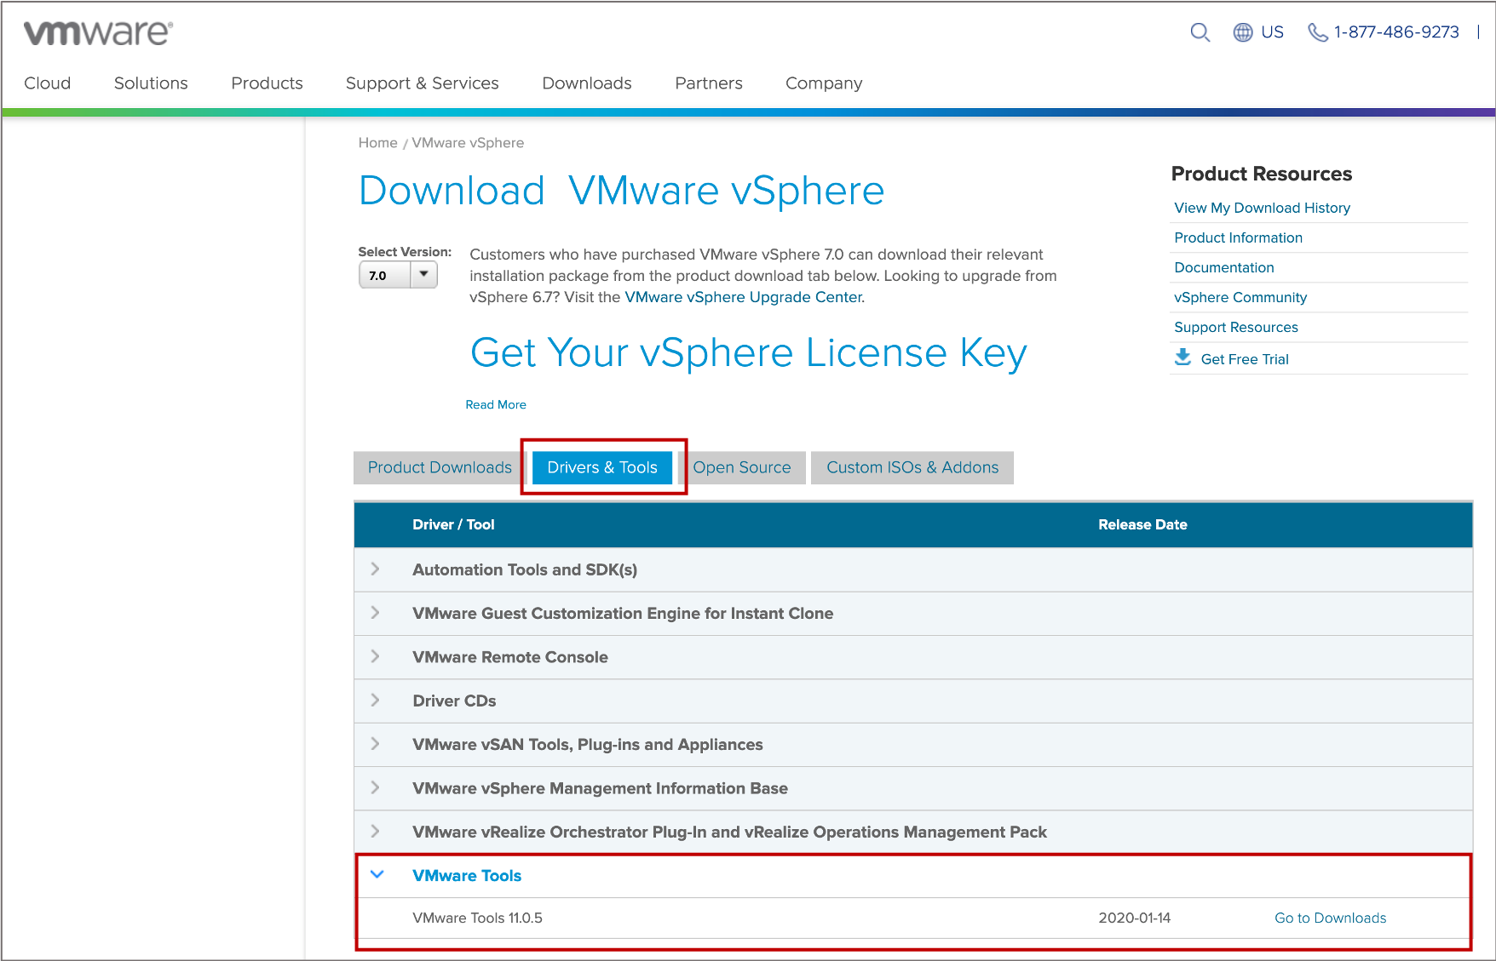
Downloading VMware Tools
You can download a specific version of VMware Tools from the VMware vSphere product download page.

Slide 16
Labs
Lab: Creating a Virtual Machine Lab: Installing VMware Tools

Slide 17
Lab 3: Creating a Virtual Machine
Use VMware Host Client to create and delete a virtual machine:
Create a Virtual Machine
Delete the Virtual Machine

Slide 18
Lab 4: Installing VMware Tools
Use VMware Host Client to install VMware Tools into an existing Windows VM:
Power On and Open a Console to the VM
Install VMware Tools

Slide 19
Review of Learner Objectives
After completing this lesson, you should be able to meet the following objectives:
Create and provision a virtual machine
Describe how to import a virtual appliance OVF template
Explain the importance of VMware Tools
Install VMware Tools

Slide 20
Lesson 2: Virtual Machine Hardware Deep Dive

Slide 21
Learner Objectives
After completing this lesson, you should be able to meet the following objectives:
Identify the files that make up a VM
Compare VM hardware versions
Recognize the components of a VM
Navigate the vSphere Client and examine VM settings
Identify methods for accessing a VM console
Identify virtual network adapters, including the enhanced VMXNET3
Distinguish between types of virtual disk provisioning

Slide 22
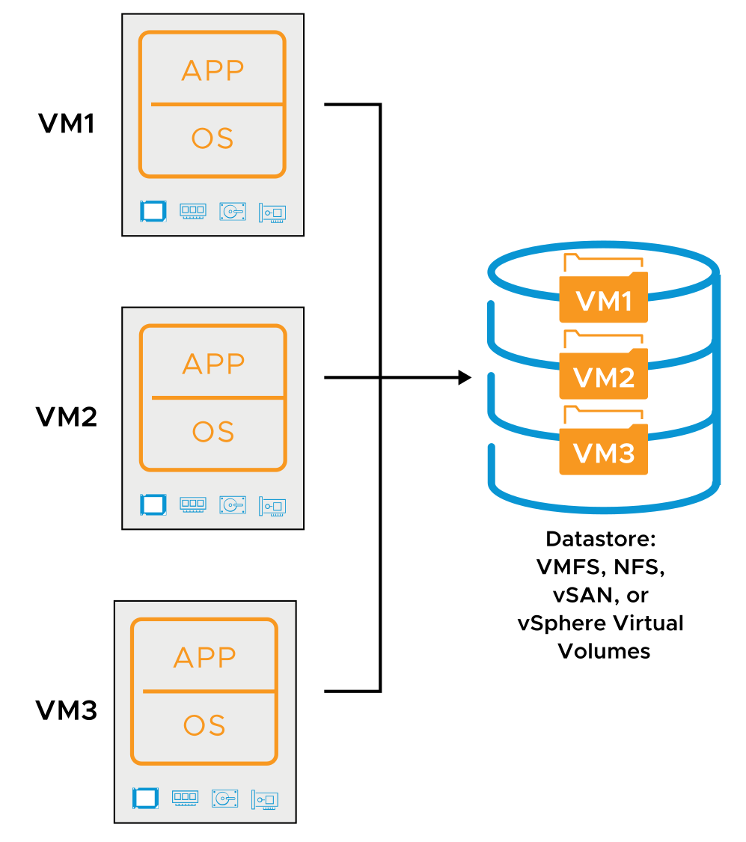
Virtual Machine Encapsulation
vSphere encapsulates each VM into a set of VM files.
VM files are stored in directories on a VMFS, NFS, vSAN, or vSphere Virtual Volumes datastore.
Notes:
vSphere encapsulates each VM into a few files or objects, making VMs easier to manage and migrate. The files and objects for each VM are stored in a separate folder on a datastore.

Slide 23
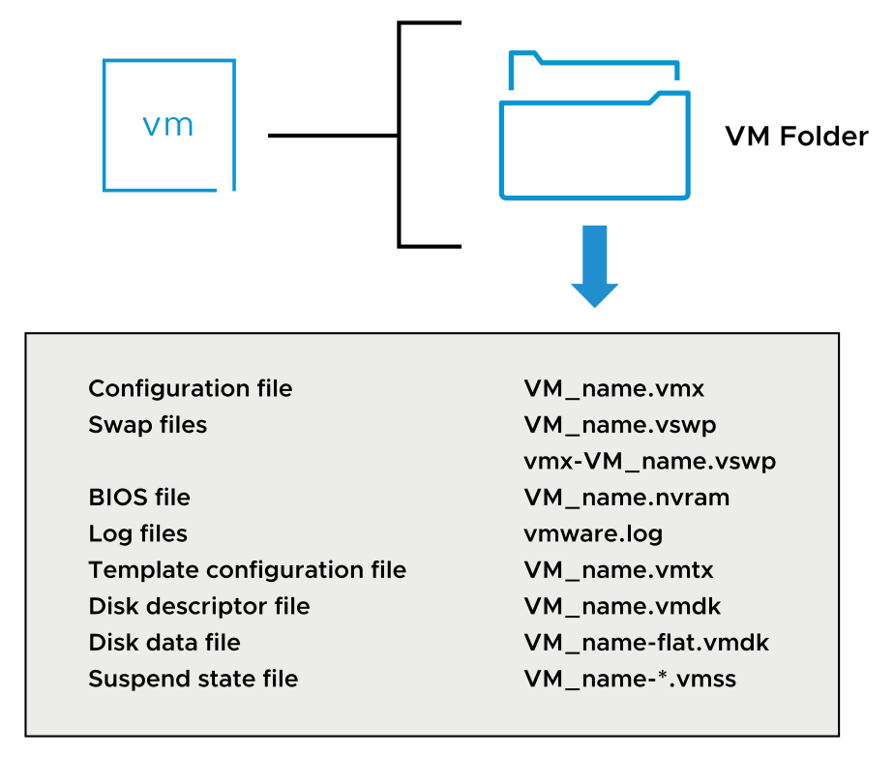
About Virtual Machine Files
A VM includes a set of related files.
Notes:
The slide lists some of the files that make up a VM. Except for the log files, the name of each file starts with the VM's name <VM_name>. A VM consists of the following files:
A configuration file (.vmx).
Swap files (.vswp) used to reclaim memory during periods of contention.
A file containing the VM's BIOS settings (.nvram).
A VM's current log file (.log) and a set of files used to archive old log entries (-#.log).
In addition to the current log file, vmware.log, up to six archive log files are maintained at one time. For example, -1.log to -6.log might exist at first. The next time an archive log file is created, for example, when the VM is powered off and powered back on, the following actions occur: The -6.log is deleted, the -5.log is recalled to -6.log, and so on. Finally, the previous vmware.log is recalled to the -1.log.
One or more virtual disk files. The first virtual disk has files VM_name.vmdk and VM_name-flat.vmdk.
If the VM has more than one disk file, the file pair for the subsequent disk files is called VM_name_#.vmdk and VM_name_#-flat.vmdk. # is the next number in the sequence, starting with 1. For example, if the VM called Test01 has two virtual disks, this VM has the Test01.vmdk, Test01-flat.vmdk, Test01_1.vmdk, and Test01_1-flat.vmdk files.
If the VM is converted to a template, a VM template configuration file (.vmtx) replaces the VM configuration file (.vmx). A VM template is a master copy of the VM.
The list of files shown on the slide is not comprehensive. For a complete list of all the types of VM files, see vSphere Virtual Machine Administration at https://docs.vmware.com/en/VMware-vSphere/7.0/com.vmware.vsphere.vm_admin.doc/GUID-55238059-912E-411F-A0E9-A7A536972A91.html.

Slide 24
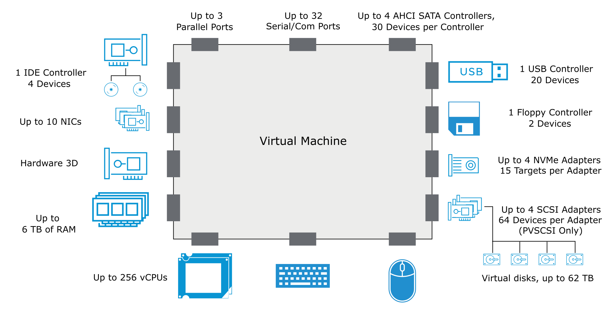
About VM Virtual Hardware
A VM uses virtual hardware.
Notes:
Each guest OS sees ordinary hardware devices. The guest OS does not know that these devices are virtual. All VMs have uniform hardware, except for a few variations that the system administrator can apply. Uniform hardware makes VMs portable across VMware virtualization platforms.
You can configure VM memory and CPU settings. vSphere supports many of the latest CPU features, including virtual CPU performance counters. You can add virtual hard disks and NICs. You can also add and configure virtual hardware, such as CD/DVD drives, and SCSI devices. Not all devices are available to add and configure. For example, you cannot add video devices, but you can configure available video devices and video cards.
You can add multiple USB devices, such as security dongles and mass storage devices, to a VM that resides on an ESXi host to which the devices are physically attached. When you attach a USB device to a physical host, the device is available only to VMs that reside on that host. Those VMs cannot connect to a device on another host in the data center. A USB device is available to only one VM at a time. When you remove a device from a VM, it becomes available to other VMs that reside on the host.
You can add up to 16 PCI vSphere DirectPath I/O devices to a VM. The devices must be reserved for PCI passthrough on the host on which the VM runs. Snapshots are not supported with vSphere DirectPath I/O pass-through devices.
The SATA controller provides access to virtual disks and CD/DVD devices. The SATA virtual controller appears to a virtual machine as an AHCI SATA controller.
The Virtual Machine Communication Interface (VMCI) is an infrastructure that provides a high-speed communication channel between a VM and the hypervisor. You cannot add or remove VMCI devices.
The VMCI SDK facilitates the development of applications that use the VMCI infrastructure. Without VMCI, VMs communicate with the host using the network layer. Using the network layer adds overhead to the communication. With VMCI, communication overhead is minimal and tasks that require communication can be optimized. VMCI can go up to nearly 10 Gbit/s with 128 K sized queue pairs.
The following types of communication are available:
Datagrams: Connectionless and similar to UDP queue pairs
Connection oriented: Similar to TCP
VMCI provides socket APIs that are similar to APIs that are used for TCP/UDP applications. IP addresses are replaced with VMCI ID numbers. For example, you can port netperf to use VMCI sockets instead of TCP/UDP. VMCI is disabled by default.
For more information about virtual hardware, see vSphere Virtual Machine Administration at https://docs.vmware.com/en/VMware-vSphere/7.0/com.vmware.vsphere.vm_admin.doc/GUID-55238059-912E-411F-A0E9-A7A536972A91.html.

Slide 25
Virtual Hardware Versions
The virtual hardware version, or VM compatibility level, determines the operating system functions that a VM supports.
Do not use a later version that is not supported by the VMware product.
Compatibility | Virtual Hardware Version
ESXi 7.0 | 17
ESXi 6.7 U2 and later | 15
ESXi 6.7 and later | 14
ESXi 6.5 and later | 13
ESXi 6.0 and later | 11
Virtual hardware versions 12 and 16 are specific to Workstation and Fusion Pro.
Notes:
Each release of a VMware product has a corresponding VM hardware version included. The table shows the latest hardware version that each ESXi version supports. Each VM compatibility level supports at least five major or minor vSphere releases.
For a complete list of virtual machine configuration maximums, see VMware Configuration Maximums at https://configmax.vmware.com.

Slide 26
About CPU and Memory
You can add, change, or configure CPU and memory resources to improve VM performance.
The maximum number of virtual CPUs (vCPUs) that you can assign to a VM depends on the following factors:
The number of logical CPUs on the host
The type of installed guest operating system
A VM running on an ESXi 7.0 host can have up to 256 vCPUs.
The maximum memory size of a VM depends on the VM’s compatibility setting.
The maximum memory size of a VM with ESXi 7.0 compatibility running on ESXi 7.0 is 6 TB.
Notes:
You size the VM's CPU and memory according to the applications and the guest operating system.
You can use the multicore vCPU feature to control the number of cores per virtual socket in a VM. With this capability, operating systems with socket restrictions can use more of the host CPU’s cores, increasing overall performance.
A VM cannot have more virtual CPUs than the number of logical CPUs on the host. The number of logical CPUs is the number of physical processor cores, or twice that number if hyperthreading is enabled. For example, if a host has 128 logical CPUs, you can configure the VM for 128 vCPUs.
You can set most of the memory parameters during VM creation or after the guest operating system is installed. Some actions require that you power off the VM before changing the settings. The memory resource settings for a VM determine how much of the host’s memory is allocated to the VM. The virtual hardware memory size determines how much memory is available to applications that run in the VM. A VM cannot benefit from more memory resources than its configured virtual hardware memory size. ESXi hosts limit the memory resource use to the maximum amount useful for the VM so that you can accept the default of unlimited memory resources. You can reconfigure the amount of memory allocated to a VM to enhance performance. Maximum memory size for a VM depends on the VM’s compatibility setting.

Slide 27
About Virtual Storage
Virtual disks are connected to virtual storage adapters.
The ESXi host offers VMs several choices in storage adapters:
BusLogic Parallel
LSI Logic Parallel
LSI Logic SAS
VMware Paravirtual SCSI
AHCI SATA controller
Virtual NVMe
Notes:
Storage adapters provide connectivity for your ESXi host to a specific storage unit or network.
ESXi supports different classes of adapters, including SCSI, iSCSI, RAID, Fibre Channel, Fibre Channel over Ethernet (FCoE), and Ethernet. ESXi accesses the adapters directly through device drivers in the VMkernel:
BusLogic Parallel: The latest Mylex (BusLogic) BT/KT-958 compatible host bus adapter.
LSI Logic Parallel: The LSI Logic LSI53C10xx Ultra320 SCSI I/O controller is supported.
LSI Logic SAS: The LSI Logic SAS adapter has a serial interface.
VMware Paravirtual SCSI: A high-performance storage adapter that can provide greater throughput and lower CPU use.
AHCI SATA controller: Provides access to virtual disks and CD/DVD devices. The SATA virtual controller appears to a VM as an AHCI SATA controller. AHCI SATA is available only for VMs with ESXi 5.5 and later compatibility.
Virtual NVMe: NVMe is an Intel specification for attaching and accessing flash storage devices to the PCI Express bus. NVMe is an alternative to existing block-based server storage I/O access protocols.

Slide 28
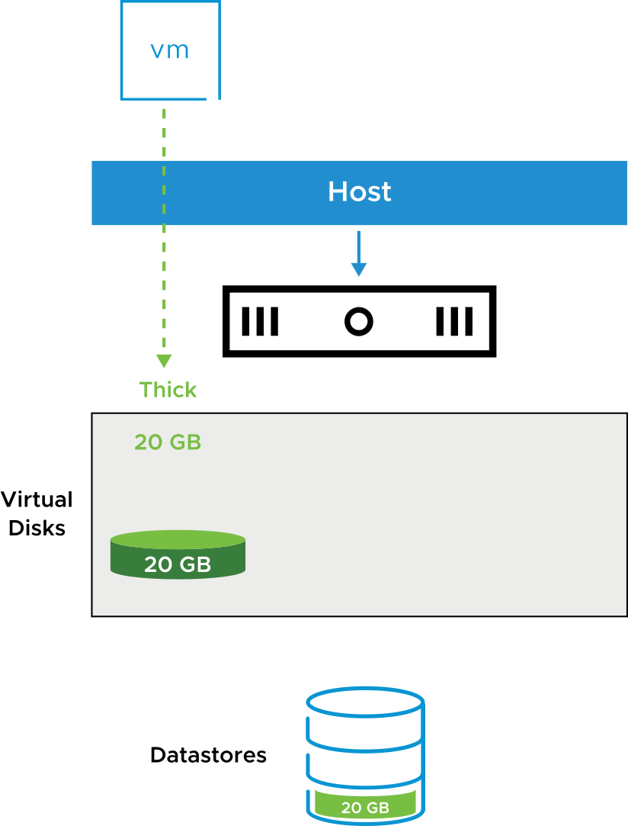
About Thick-Provisioned Virtual Disks
Thick provisioning uses all the defined disk space at the creation of the virtual disk.
VM disks consume all the capacity, as defined at creation, regardless of the amount of data in the guest operating system file system.
Thick-provisioned disk types are eager zeroed or lazy zeroed:
In an eager-zeroed thick-provisioned disk, every block is prefilled with a zero.
In a lazy-zeroed thick-provisioned disk, every block is filled with a zero when data is written to the block.
Notes:
In a lazy-zeroed thick-provisioned disk, space required for the virtual disk is allocated during creation. Data remaining on the physical device is not erased during creation. Later, the data is zeroed out on demand on first write from the VM. This disk type is the default.
In an eager-zeroed thick-provisioned disk, the space required for the virtual disk is allocated during creation. Data remaining on the physical device is zeroed out when the disk is created.

Slide 29
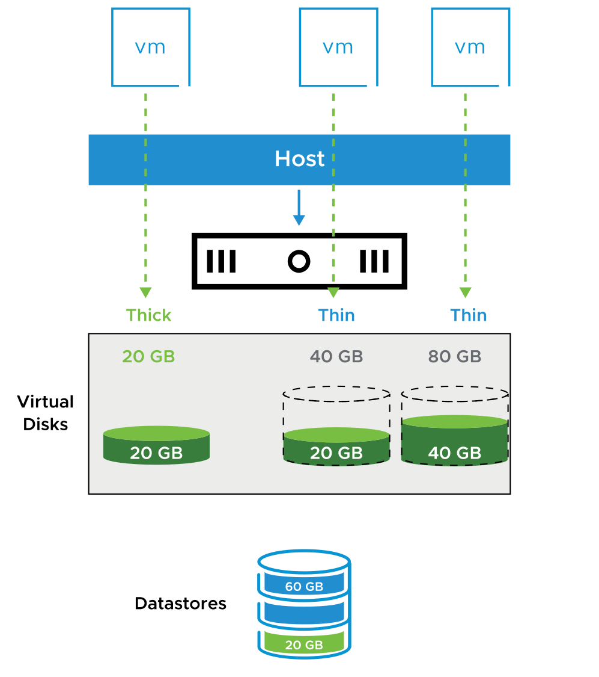
About Thin-Provisioned Virtual Disks
With thin provisioning, VMs use storage space as needed:
Virtual disks consume only the capacity needed to hold the current files.
The VM always sees the full allocated disk size.
Run the unmap command to reclaim unused space from the array.
Reporting and alerts help manage allocations and capacity.
You can mix thick and thin formats.
More efficient use of storage, for example:
Provisioned space for virtual disks: 140 GB
Available datastore capacity: 100 GB
Used datastore capacity: 80 GB
Notes:
A thin-provisioned disk uses only as much datastore space as the disk initially needs. If the thin disk needs more space later, it can expand to the maximum capacity allocated to it.
Thin provisioning is often used with storage array deduplication to improve storage use and to back up VMs.
Thin provisioning provides alarms and reports that track allocation versus current use of storage capacity. Storage administrators can use thin provisioning to optimize the allocation of storage for virtual environments. With thin provisioning, users can optimally but safely use available storage space through overallocation.

Slide 30
Thick-Provisioned and Thin-Provisioned Disks
Virtual disk options differ in terms of creation time, block allocation, layout, and zeroing out of allocated file blocks.
 | Thick Provisioned Lazy-Zeroed | Thick Provisioned Eager-Zeroed | Thin Provisioned
Creation time | Fast. | Slow and proportional to disk size. | Fastest.
Block allocation | Fully preallocated. | Fully preallocated. | Allocated and zeroed out on demand at first write to block.
Virtual disk layout | Higher chance of contiguous file blocks. | Higher chance of contiguous file blocks. | Layout varies according to the dynamic state of the volume at time of block allocation.
Zeroing out of allocated file blocks | File blocks are zeroed out when each block is first written to. | File blocks are allocated and zeroed out when disk is created. | File blocks are zeroed out when blocks are allocated.

Slide 31
About Virtual Networks
VMs and physical machines communicate through a virtual network.
When you configure networking for a VM, you select or change the following settings:
Network adapter type
Port group to connect to
Network connection state
Whether to connect to the network when the VM powers on
Notes:
For more information about virtual networks, see vSphere Networking at https://docs.vmware.com/en/VMware-vSphere/7.0/com.vmware.vsphere.networking.doc/GUID-35B40B0B-0C13-43B2-BC85-18C9C91BE2D4.html.

Slide 32
About Virtual Network Adapters
When you configure a VM, you can add network adapters (NICs) and specify the adapter type. Whenever possible, select VMXNET3.
Network Adapter Type | Description
E1000-E1000E | Emulated version of an Intel Gigabit Ethernet NIC, with drivers available in most newer guest operating systems.
VMXNET3 | Available only with VMware Tools.
Flexible | Can function as either a Vlance or VMXNET adapter.
SR-IOV pass-through | Allows VM and physical adapter to exchange data without using the VMkernel as an intermediary.
vSphere DirectPath I/O | Allows VM access to physical PCI network functions on platforms with an I/O memory management unit.
PVRDMA | Paravirtualized device that provides improved virtual device performance. It provides an RDMA-like interface for vSphere guests.
Notes:
The types of network adapters that are available depend on the following factors:
VM compatibility level (or hardware version), which depends on the host that created or most recently updated it. For example, the VMXNET3 virtual NIC requires hardware version 7 (ESX/ESXi 4.0 or later).
Whether the VM compatibility is updated to the latest version for the current host.
Guest operating system
The following NIC types are supported:
E1000E: Emulated version of the Intel 82574 Gigabit Ethernet NIC. E1000E is the default adapter for Windows 8 and Windows Server 2012.
E1000: Emulated version of the Intel 82545EM Gigabit Ethernet NIC, with drivers available in most newer guest operating systems, including Windows XP and later and Linux versions 2.4.19 and later.
Flexible: Identifies itself as a Vlance adapter when a VM starts, but initializes itself and functions as either a Vlance or a VMXNET adapter, depending on which driver initializes it. With VMware Tools installed, the VMXNET driver changes the Vlance adapter to the higher performance VMXNET adapter.
Vlance: Emulated version of the AMD 79C970 PCnet32 LANCE NIC, an older 10 Mbps NIC with drivers available in 32-bit legacy guest operating systems. A VM configured with this network adapter can use its network immediately.
VMXNET2 (Enhanced): Based on the VMXNET adapter but provides high-performance features commonly used on modern networks, such as jumbo frames and hardware offloads. VMXNET2 (Enhanced) is available only for some guest operating systems on ESX/ESXi 3.5 and later. It is not supported for ESXi 6.7 and later.
VMXNET3: A paravirtualized NIC designed for performance. VMXNET3 offers all the features available in VMXNET2 and adds several new features, such as multiqueue support (also known as Receive Side Scaling in Windows), IPv6 offloads, and MSI/MSI-X interrupt delivery.
SR-IOV pass-through: Representation of a virtual function on a physical NIC with SR-IOV support. This adapter type is suitable for VMs that require more CPU resources or where latency might cause failure. If VMs are sensitive to network delay, SR-IOV can provide direct access to the virtual functions of supported physical NICs, bypassing the virtual switches and reducing overhead.
SR-IOV pass-through is available in ESXi 6.0 and later for Red Hat Enterprise Linux 6 and later, and Windows Server 2008 R2 with SP2. An operating system release might contain a default virtual function driver for certain NICs. For others, you must download and install it from a location provided by the NIC or host vendor.
vSphere DirectPath I/O allows a guest operating system on a VM to directly access physical PCI and PCIe devices connected to a host. Pass-through devices help your environment use resources efficiently and improve performance. You can configure a pass-through PCI device on a VM by using the vSphere Client. VMs configured with vSphere DirectPath I/O do not have the following features:
Hot adding and removing of virtual devices
Suspend and resume
Record and replay
Fault tolerance
High availability
vSphere DRS: Limited availability
The VM can be part of a cluster but cannot migrate across hosts.
Snapshots.
With PVRDMA, multiple guests can access the RDMA device by using verbs API, an industry-standard interface. A set of these verbs was implemented to expose an RDMA-capable guest device (PVRDMA) to applications. The applications can use the PVRDMA guest driver to communicate with the underlying physical device. PVRDMA supports RDMA, providing the following functions:
OS bypass
Zero-copy
Low latency and high bandwidth
Less power use and faster data access

Slide 33
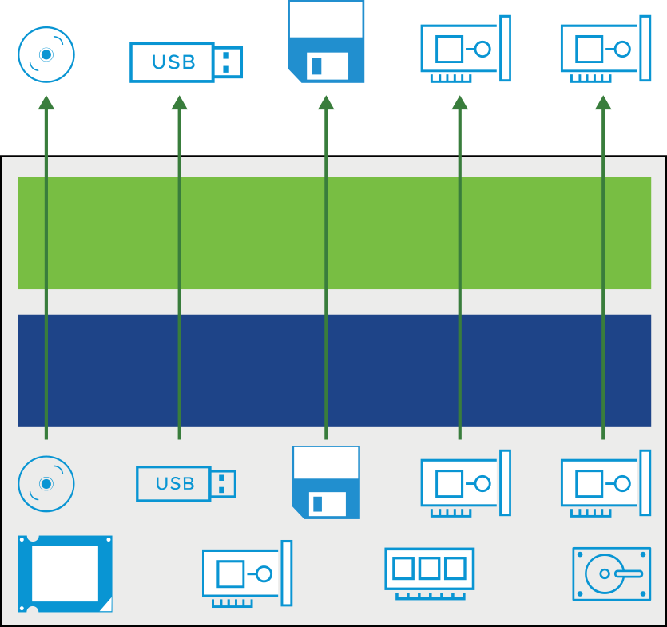
Other Virtual Devices
A VM must have a vCPU and virtual memory. The addition of other virtual devices makes the VM more useful:
CD/DVD drive: For connecting to a CD, DVD, or ISO image.
USB 3.0 and 3.1: Supported with host-connected and client-connected devices.
Floppy drive: For connecting a VM to a floppy drive or a floppy image.
Generic SCSI devices: A VM can be connected to additional SCSI adapters.
vGPUs: A VM can use GPUs on the physical host for high-computation activities.
Notes:
Virtual CPU (vCPU) and virtual memory are the minimum required virtual hardware. Having a virtual hard disk, virtual NICs, and other virtual devices make the VM more useful.
For information about adding virtual devices to a VM, see vSphere Virtual Machine Administration at https://docs.vmware.com/en/VMware-vSphere/7.0/com.vmware.vsphere.vm_admin.doc/GUID-55238059-912E-411F-A0E9-A7A536972A91.html.

Slide 34
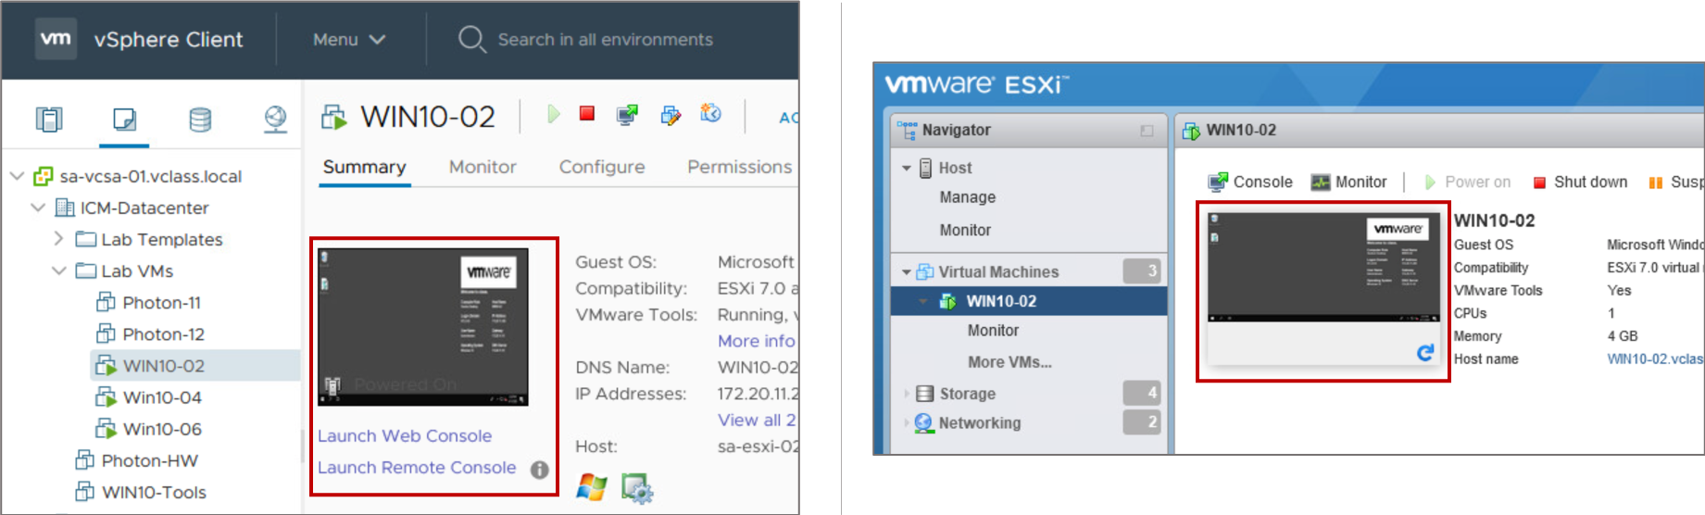
About the Virtual Machine Console
The VM console provides the mouse, keyboard, and screen features to control the VM.
You can use the standalone VMware Remote Console Application (VMRC) to connect to client devices.
Notes:
You can open the VM console from the vSphere Client.
You use the VM console to access the BIOS of the VM, install an operating system on a VM, power the VM on and off, and reset the VM.
The VM console is normally not used to connect to the VM for daily tasks. Remote Desktop Connection, Virtual Network Connection, or other options are normally used to connect to the virtual desktop. The VM console is used for tasks such as power cycling, configuring hardware, and troubleshooting network issues.

Slide 35
Lab 5: Adding Virtual Hardware
Use VMware Host Client to examine a virtual machine's configuration and add virtual hardware to the virtual machine:
Examine a Virtual Machine's Configuration
Add Virtual Hard Disks to the Virtual Machine
Compare Thin-Provisioned and Thick-Provisioned Disks

Slide 36
Review of Learner Objectives
After completing this lesson, you should be able to meet the following objectives:
Identify the files that make up a VM
Compare VM hardware versions
Recognize the components of a VM
Navigate the vSphere Client and examine VM settings
Identify methods for accessing a VM console
Identify virtual network adapters, including the enhanced VMXNET3
Distinguish between types of virtual disk provisioning

Slide 37
Lesson 3: Introduction to Containers

Slide 38
Learner Objectives
After completing this lesson, you should be able to meet the following objectives:
Describe the benefits and use cases for containers
Identify the parts of a container system
Differentiate between containers and virtual machines

Slide 39
Traditional Application Development
In data centers, traditional applications are enhanced with modern application capabilities and models. But traditional application development is different from modern application development.
Traditional Application Development
Waterfall development | Development cycles are relatively long (several months). Requirements can change over time.
Handover to the operations team | The operations team is responsible for the code in production. Training is not provided.
Monolithic applications | All functionality is handled by a single large application. Typically, monolithic applications can only be scaled vertically, not horizontally.
Separate development, staging, and production environments | Inconsistencies between environments occur. Issues in production do not occur during staging.
Notes:
Waterfall development: Waterfall development cycles take from 6 to 12 months to deliver a product. Because this cycle is relatively long in the context of software development, requirements are at risk of changing. In addition, initial requirements might be misunderstood, but this misunderstanding might be realized only at the end of the project.
Handover to the operations team: When a product is ready for production, it is handed over to the operations team. The operations team deploys and manages the software from that point. Without proper training and documentation, the team can find it difficult to skill up and effectively manage the software.
Monolithic applications: Traditional applications are developed to run as a single large monolithic process. Large does not refer to the lines of code but to the large number of functionalities and responsibilities. Typically, traditional applications are deployed to a single VM using manual processes. And they are not typically designed to be scalable. The only option is to increase CPU, disk, and memory to achieve higher performance.
Separate environments: Developers start developing on their workstations. Eventually, code moves to testing, staging, and production environments. Each environment is manually configured, resulting in a relatively large amount of effort in all identical environments. Each environment creates different software libraries, packages, and configurations. This variation causes issues for developers who must determine why the application works in one environment but not in the others.

Slide 40
Modern Application Development
Modern application development is transforming modern business.
Modern Application Development
Typically use microservices style architectures. | Monolithic applications are broken into many smaller standalone modular functions or services that make it easier for developers to be innovative when producing and changing code.
Minimize time to market. | Streamline the process of deploying new code into a staging environment for testing. Identify and address bugs almost immediately. Quickly deploy small, incremental changes in the production environment and easily withdraw if problems arise.
Deliver updates and features quickly. | Minimize the time it takes to build, test, and release new features.
Increase product quality and avoid risk. | Automate tests, get user feedback, and improve software iteratively.
Fewer resource requirements and more productivity. | Apply continuous development and continuous integration in small iterations to reduce labor.

Slide 41
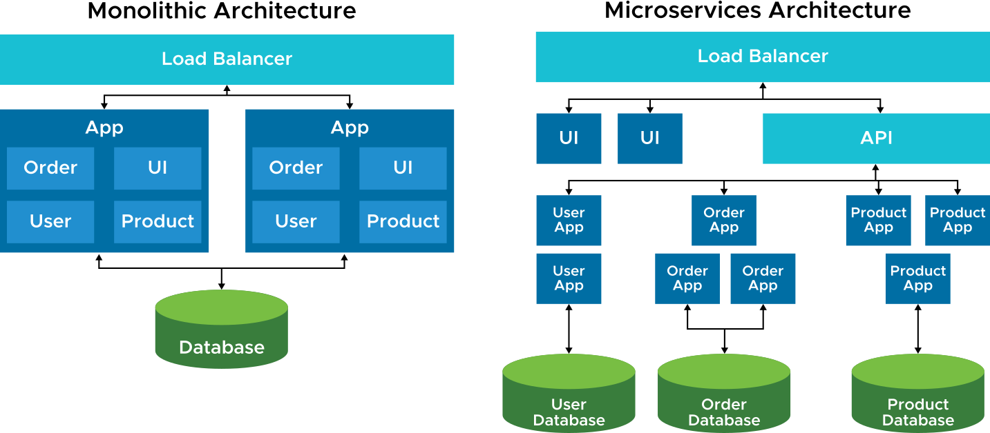
Benefits of Microservices and Containerization
Containers are an ideal technology for supporting microservices because the goals of containers (lightweight, easily packaged, can run anywhere) align well with the goals of a microservices architecture.
Notes:
Applications that run on cloud-based environments are designed with failure in mind. They are built to be resilient, to tolerate network or database outages, and to degrade gracefully.
Typically, cloud-native applications use microservice-based architectures. The term micro does not correlate to lines of code. It refers to functionality and responsibility. Each microservice should be responsible for specific parts of the system. In the example, the application is broken into multiple services, including a UI and user, order, and product services. Each service has its own database. With this architecture, each service can be scaled independently. For example, during busy times, the order service might need to be scaled to handle high throughput.
The Twelve-Factor App principles describe characteristics of microservice and cloud-native applications.

Slide 42
Container Terminology
Several terms and concepts apply to containers.
Term | Definition
Container | An application packaged with dependencies
Container engine | A runtime engine that manages the containers
Docker | The most recognized runtime engine for container support, and it is often used as a synonym for many aspects of container technologies
Container host | A virtual machine or physical machine on which the containers and container engine run
Kubernetes | Google-developed orchestration for containers

Slide 43
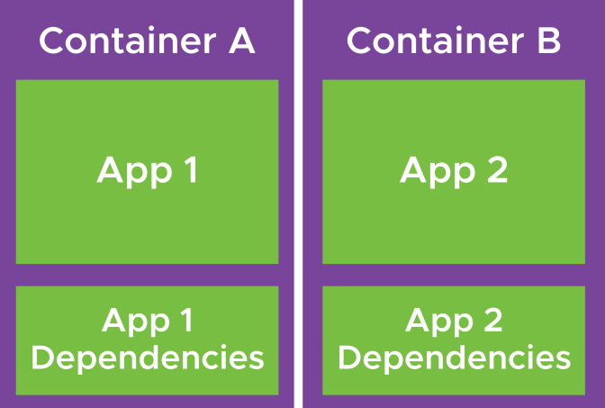
About Containers
A container is an encapsulation of an application and dependent binaries and libraries. The application is decoupled from the operating system and becomes a serverless function.
Among the reasons that containers were popularized by software developers are:
They make coding easier, locally and anywhere.
You can deploy and test applications quickly in a staging environment. No operating system or load is required.

Slide 44
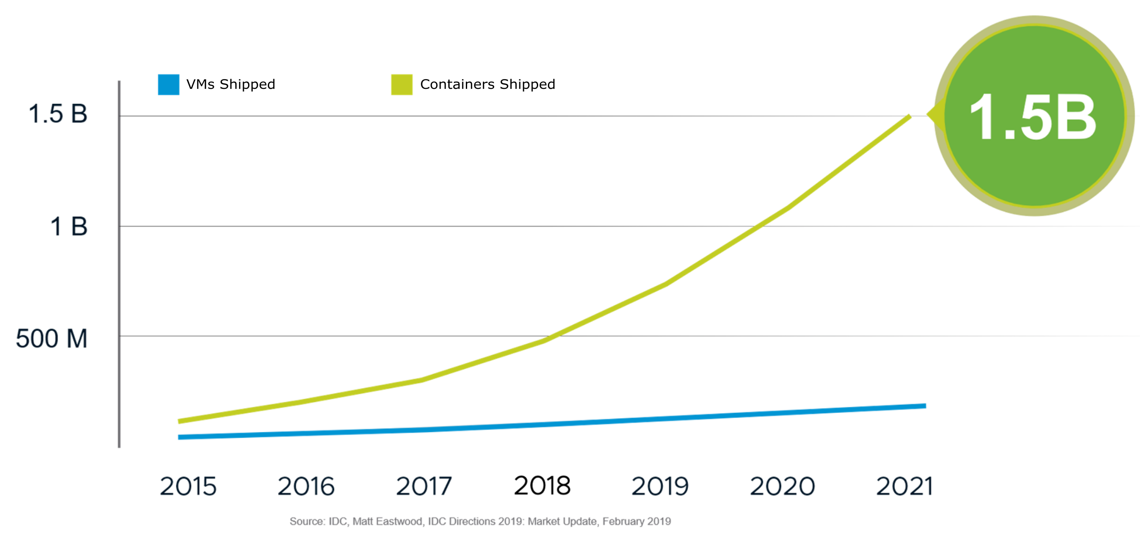
Rise of Containers
Application developers are quickly adopting container technology as their tool of choice.
Notes:
Containers are a new format of virtualized workload. They require CPU, memory, network, security, and storage.
Containers satisfy developers’ need for speed by removing dependencies on underlying operating systems:
Change the paradigm on security by using a discard and restart approach to patching and upgrades.
Use structured tooling to fully automate updates of application logic running inside.
Provide an easy user experience for developers that is infrastructure-agnostic (meaning that it can run on any cloud).
The opportunities containers present are many, given the infrastructure and operational complexity that they offer.

Slide 45
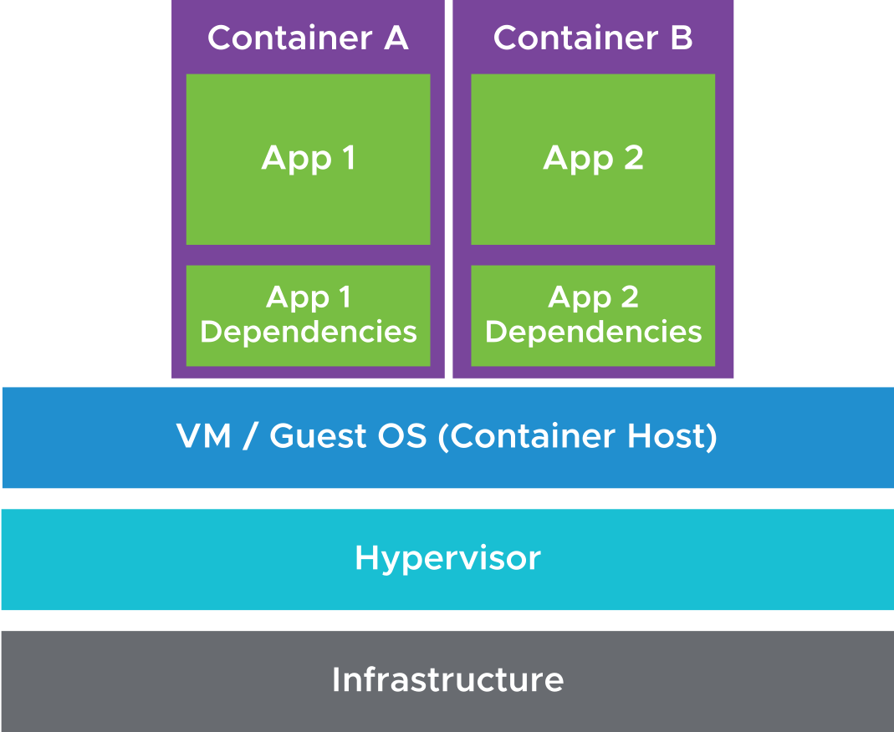
About Container Hosts
The container host runs the operating system on which the containers run.
Container hosts can be of the following types:
Standard OS with a container engine installed:
Ubuntu with Docker
OS developed specifically with containers in mind:
Photon OS
Fedora CoreOS
Virtual machine or physical machine:
Among the many benefits of using VMs are easy management and scalability.
Notes:
Administrators provide container hosts, which are the base structure that developers use to run their containers. A robust microservices system includes more deliverables, many of which are built using containers.
For developers to focus on providing services to customers, operations must provide a reliable container host infrastructure.
In vSphere with Kubernetes, the container hosts are Photon-based VMs.

Slide 46
Containers at Runtime
Containers have the following characteristics:
A container can run on any container host with the same operating system kernel that is specified by that container.
A running container is accessed using its FQDN or its unique IP address.
Each container can access only its own resources in the shared environment.
When you log into a container using a remote terminal (such as SSH), you see no indication that other containers are running on the same container host.

Slide 47
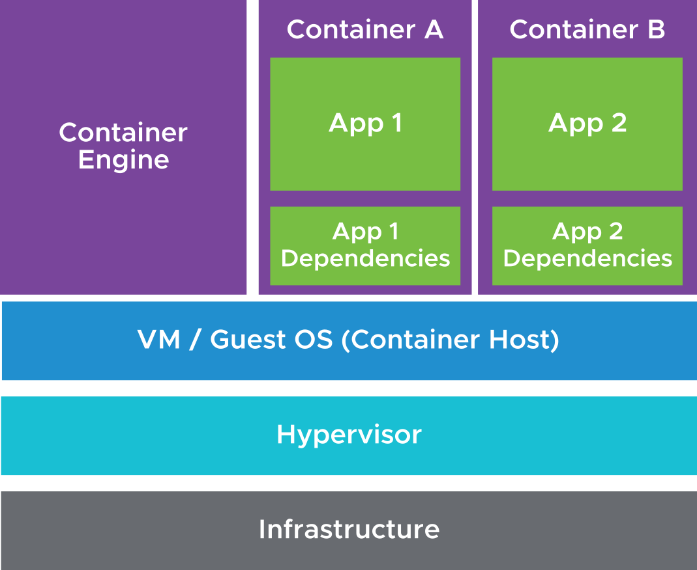
Container Engines
A container engine is a control plane that is installed on each container host. The control plane manages the containers on that host.
Container engines perform several functions:
Build container images from source code (for example, Dockerfile). Alternatively, load container images from a repository.
Create running containers based on a container image.
Commit a running container to an image.
Save an image and push it to a repository.
Stop and remove containers.
Suspend and restart containers.
Report container status.
Notes:
Docker is the most commonly used container engine. The container engine runs as a daemon process on the container host OS. When a user requests that a container is run, the container engine gets the container image from an image registry (or locally, if already downloaded) and runs the container as a process.

Slide 48
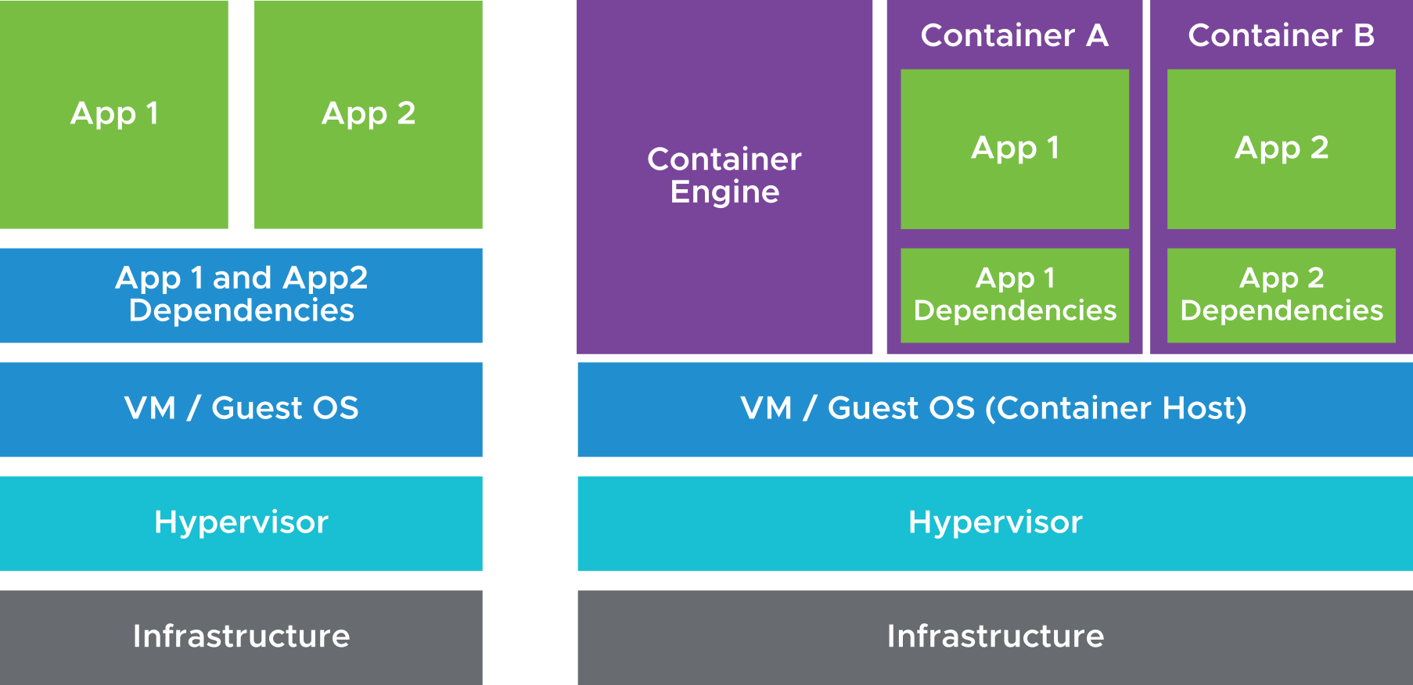
Virtual Machines and Containers (1)
VMs provide virtual hardware that the guest OS uses to run applications. Multiple applications run on a single VM but they are logically separated and isolated.
With containers, developers take a streamlined base OS file system and layer on only the required binaries and libraries that the application depends on.
Notes:
With virtualization, multiple physical machines can be consolidated into a single physical machine that runs multiple VMs. Each VM provides virtual hardware that the guest OS uses to run applications. Multiple applications run on a single VM but these applications are still logically separated and isolated.
A concern about VMs is that they are hundreds of megabytes to gigabytes in size and contain many binaries and libraries that are not relevant to the main application running on them.
With containers, developers take a streamlined base OS file system and layer on only the required binaries and libraries that the application depends on. When a container is run as a process on the container host OS, the container can see its dependencies and base OS packages. The container is isolated from all other processes on the container host OS. The container processes are the only processes that run on a minimal system.
From the container host OS perspective, the container is another process that is running, but it has a restricted view of the file system and potentially restricted CPU and memory.

Slide 49
Virtual Machines and Containers (2)
VMs and containers work in different ways.
Virtual Machines | Containers
Encapsulation of an entire operating system | Encapsulation of an application and dependent binaries or libraries
Scheduled by the hypervisor | Scheduled by the container host OS
Run on the hypervisor | Run on the container host OS
Starting a VM means starting an operating system (seconds to minutes) | Starting a container means starting the application process (milliseconds to seconds)
Notes:
Containers are the ideal technology for microservices because the goals of containers (lightweight, easily packaged, can run anywhere) align with the goals and benefits of the microservices architecture.
Operators get modularized application components that are small and can fit into existing resources.
Developers can focus on the logic of modularized application components, knowing that the infrastructure is reliable and supports the scalability of modules.

Slide 50
About Kubernetes
Containers are managed on a single container host. Managing multiple containers across multiple container hosts creates many problems:
Managing large numbers of containers
Restarting failed containers
Scaling containers to meet capacity
Networking and load balancing
Kubernetes provides an orchestration layer to solve these problems.
Kubernetes is an open-source system for automating deployment, scaling, and management of containerized applications.
Notes:
Kubernetes automates many key operational responsibilities, providing the developer with a reliable environment.
Kubernetes performs the following functions:
Groups containers that make up an application into logical units for easy management and discovery
Automatically places containers based on their resource requirements
Restarts failed containers, replaces and reschedules containers when hosts fail, and stops containers that do not respond to your user-defined health check
Progressively rolls out changes to your application, ensuring that it does not stop all your instances at the same time and enabling zero downtime
Allocates IP addresses, mounts the storage system of your choice, load balances, and generally looks after the containers
Kubernetes manages containers across multiple container hosts, similar to how vCenter Server manages all ESXi hosts in a cluster. Running Docker without Kubernetes is like running ESXi hosts without vCenter Server to manage them.

Slide 51
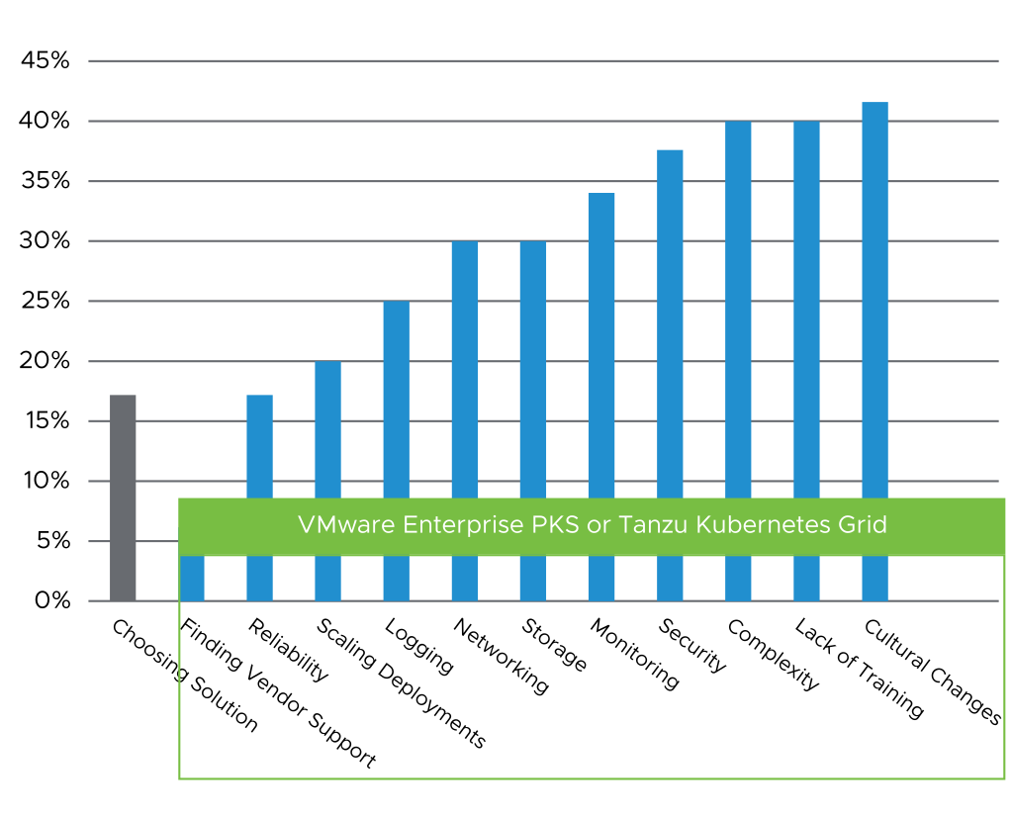
Challenges of Running Kubernetes in Production
The top challenges of running Kubernetes are reliability, security, networking, scaling, logging, and complexity.
All Solved by the VMware PKS Solution
Source: Cloud native Computing Foundation User Survey 2019
Notes:
Kubernetes orchestrates containers that support the application. However, running Kubernetes in production is not easy, especially for operations teams. The top challenges of running Kubernetes are related to reliability, security, networking, scaling, logging, and complexity. How do you monitor Kubernetes and the underlying infrastructure? How do you build a reliable platform to deploy your applications? How do you handle the complexity that this layer of abstraction introduces? For years, VMware has helped to solve these types of problems for IT. VMware can offer its expertise and solutions in this area.

Slide 52
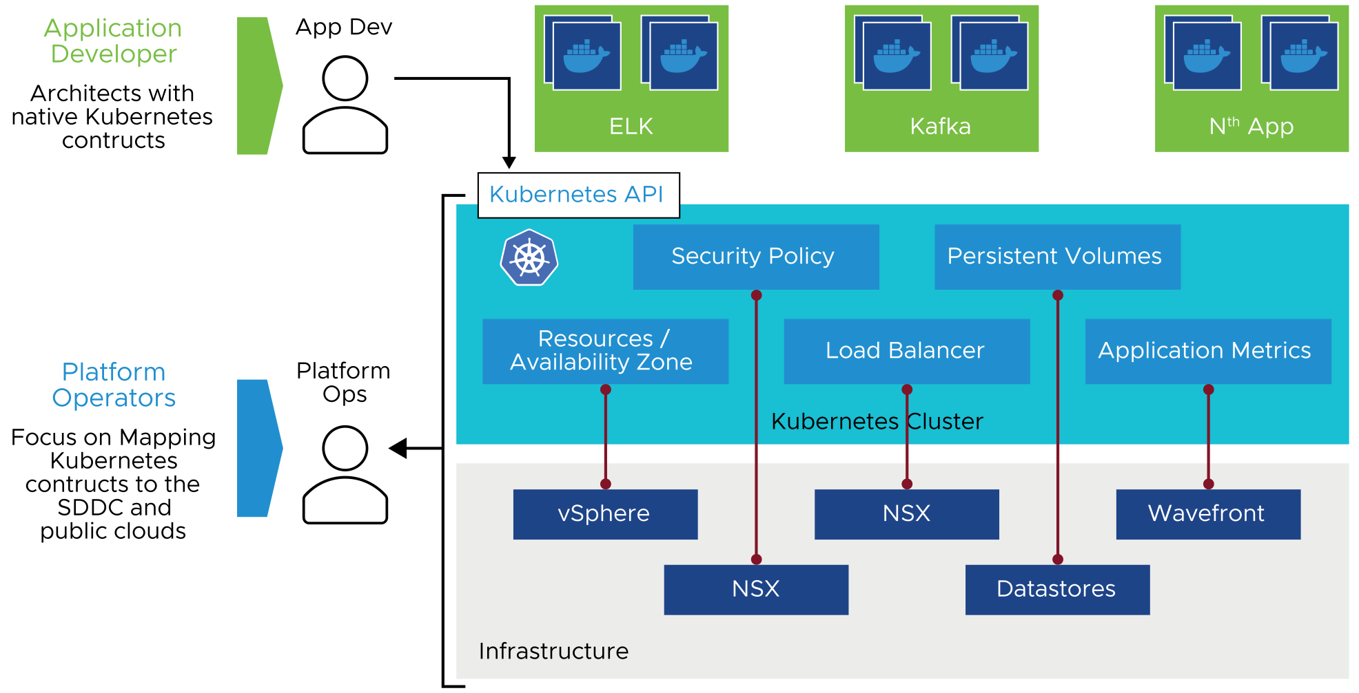
Architecting with Common Application Requirements
AppDev
Platform Ops
Infrastructure
Notes:
Application developers prefer using Kubernetes rather than programming to the infrastructure. For example, an application developer must build an ELK stack. The developer prefers to deal with the Kubernetes API. The developer wants to use the resources, load balancer, and all the primitives that Kubernetes constructs, rather than worry about the underlying infrastructure.
But the infrastructure is still there. It must be mapped for Kubernetes to use it. Usually, that mapping is done by a platform operator so the developer can use the Kubernetes constructs. The slide shows how the mapping is done with the VMware software-defined data center (SDDC). The resources and availability zones map to vSphere clusters, security policy and load-balancing map to NSX, persistent volumes map to vSphere datastores and metrics map to Wavefront. Each of these items provides value.

Slide 53
Review of Learner Objectives
After completing this lesson, you should be able to meet the following objectives:
Describe the benefits and use cases for containers
Identify the parts of a container system
Differentiate between containers and virtual machines

Slide 54
Virtual Beans: Virtualizing Workloads
As a Virtual Beans administrator, you want to start creating VMs with different configurations and testing your applications.
Your key takeaways are:
The VMware Compatibility Guide can help you determine what versions of Windows and Linux guest operating systems are supported in ESXi 7.0.
Virtual machines support a wide selection of virtual hardware devices, for example, vGPUs and NVME adapters.
vSphere provides the underlying infrastructure on which containers and Kubernetes run.

Slide 55
Key Points
A VM is a set of files that are encapsulated into a folder and placed on a datastore.
VMs can be provisioned using the vSphere Client and VMware Host Client.
VMware Tools increases the overall performance of the VM's guest operating system.
The virtual hardware version, or VM compatibility level, determines the operating system functions that a VM supports.
Containers are the ideal technology for microservices because the goals of containers align with the goals and benefits of the microservices architecture.
Questions?

